Slide 1
CST-235 Computer Programming III
Topic 1 (1 week)

Slide 2
Introductions – Who is Mark?
Who is your Professor?
My name is Mark Reha. I am a full time faculty member at GCU and have taught engineering, computer science, and computer programming classes for a few years here in the valley.
I previously worked in the industry for almost 35 years and most currently at American Express as a Solutions Architect working on the Amex Private and Public Clouds as well as other initiatives such as DevOps. Prior to that I worked in Silicon Valley for over 20 years.
I have previously held positions as a Director of Software, Engineering Manager, Enterprise Architect, and Applications Architect.
I enjoy technology, sports, and music.
I hold 5 patents, am the author of a book, and have published 2 applications to the Apple App Store and Google Play Store.
I hold a BSEE from DeVry and a MSAET from University of Phoenix.
You can simply address me as Professor Mark.
What is the best way to get in touch with me?
LoudCloud as well as see my published Office Hours
Email Address: mark.reha@gcu.edu
LinkedIn Profile: https://www.linkedin.com/in/markreha
IMPORTANT: I am not available on Saturday or Sunday

Slide 3
Course Orientation

Slide 4
Class Expectations and Policies
Please login into Loud Cloud
Go to the Welcome Announcement in your Messages
Review General Class expectations
Review Participation expectations
Review Class policies

Slide 5
Checking In
Video: http://tutorials.gcumedia.com/mediaElements/success-patrol/v1.1/
Reminder: You must declare your intent to continue in the course by answering the “Welcome” DQ within 7 days of the start of the term to demonstrate that you are actively enrolled in this class.
Any students who do not post in the LMS within the first 7 days may be dropped from the class.

Slide 6
Format of my Classes
Review from Previous Week
Lecture: Topic Slides + Code Snippets + Discussions (~30%)
Lab: Hands on Coding Activities/Assignments (~70%)
Lesson Closure
Please read your Announcements in your Loud Cloud Messages Forum.
I will also be providing you extra class and industry resources as an Announcement in the Loud Cloud Messages Forum.
I have setup a Question and Answer Thread in the QFI Forum.

Slide 7
Course Description
Syllabus: This course covers user interfaces, event and exception handling, Java I/O, and the collection framework. Students build applications using software engineering methods including design models and implementation/testing strategies, while learning to assume professional responsibilities.
Mark: You will also learn how to design an N-Layer Enterprise Web Application using UML, industry standard Design Patterns, and a leverage a popular MVC design pattern using JavaServer Faces in Enterprise Java. You will also learn EJB’s, MDB’s, and build services in JAX-RS and JAX-WS.

Slide 8
Course Topics
The following Topics are covered in this course:
Topic 1: Introduction to Java EE (1 Week)
Topic 2: Presentation Layer in Java EE (4 Weeks)
Topic 3: Business Layer in Java EE (2 Weeks)
Topic 4: Data Access Layer in Java EE (3 Weeks)
Topic 5: Integration Layer in Java EE (3 Week)
Topic 6: Security in Java EE (2 Weeks)
And much much more.......
There is no doubt in my mind that if you apply yourself in the class you will have a fantastic foundation in Enterprise Java!

Slide 9
Class Assignment Summary
There are 6 major Milestone assignments that are part of the CLC Project. You will also present your application to the class. These assignments make up 53% of your grade.
There are 6 in-class activity (short) assignments that are based upon a combination of in-class activities, quizzes, extra assignments as requested by myself that includes pre-tests or pre-topic activities (if applicable). These assignments make up 32% of your grade.
There is also participation points for this class that make up 15% of your grade.
This course has been modified so the Syllabus and Loud Cloud are not accurate.

Slide 10
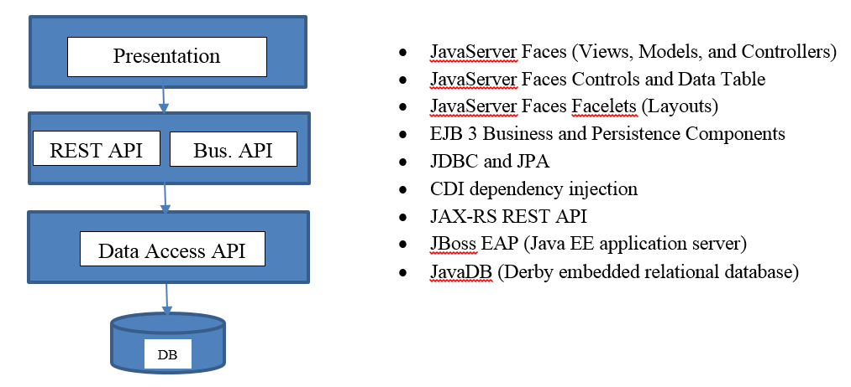
Project Overview
In this class you will design and build a complete enterprise class N-Layer application using Enterprise Java technologies, that meets a certain set of functional and technical requirements, and as shown in the figure below.
The Class Project has changed!

Slide 11
Project Requirements
You will have the freedom to pick the application you want to design and develop.
The business and technical requirements, using a wide variety of technologies from the Enterprise Java stack, will be outlined for you.
You will work in teams of no more than 2 unless there is an odd number of students in which case a team of 3 will be acceptable.
Your design will be captured in a formal Design Report using a template provided.
Example applications could include but not limited to:
An eCommerce application
Customer Management application
Order Management application
Blog Site application
DVD/Book/Music Management application
Etc.
Please pull up the Project Requirements from the Assignment.

Slide 12
Short Assignment Overview
There will be lots of opportunity to apply topics we cover in lectures using hands on short assignments (i.e. in-class activities).
The short assignments will give you individual hands on coding experience with many of the design patterns and technologies we will cover in class. You should be able to apply some of the code toward your CLL Project Assignment.
We will be covering the following technologies in our short assignments:
1 Java EE stack assignment on layered architecture
1 JSP and Servlet assignment
3 JSF assignments
3 EJB assignments
1 CDI assignment
1 REST assignment
1 MDB assignment
1 Security assignment

Slide 13
Class Discussion
What are you excited about learning in this class?
What do you think will be the most challenging?
What are you most nervous/anxious about?
Are there other general topics you want me to go further into detail from your Level II class?
Source Control / Bitbucket?
OO in Java?

Slide 14
Lectures for Topic 1
Lectures:
Topic 1 Project Assignment Requirements.
Introduction to Enterprise Java.
N-Layer Architecture and N-Tier Architecture.
Hands On:
Tools Install.
Build a simple Java Servlet app.
Research N-Layer Architecture.

Slide 15
Review Topic 1 Assignment Requirements
Please pull up the Assignment #1 from the Announcement
Review the Requirements
This is due this week.
The Class Project has changed. Please pull up the Project Requirements from the Assignment.
I need a list of your team members! See Announcement.

Slide 16
Introduction to Enterprise Java

Slide 17
Discussion - What is Enterprise Java?
What is Java?
What is Enterprise Java?
What is the difference between the two?

Slide 18
What is Java?
Java “as a generic term” is a programming language!
Unfortunately Sun did a poor job of “marketing” Java unlike Microsoft where this is major difference between C# (the programming language) and .NET (the platform).
Java != JavaScript either.
There are really 2 major Java platforms:
Standard Java: Java SE, which is your base platform.
Enterprise Java: Java EE, which enables you to build web applications.
There are other Java platforms too:
Java ME, Java RT, Java TV, Java Card, etc.
Update your resume accordingly. Use the proper verbiage!

Slide 19
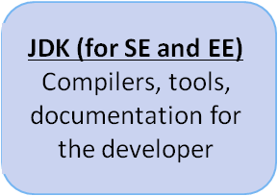
What is Enterprise Java?
Java is a programming language! Java != Enterprise Java Java as a programming language can be used to build enterprise applications as well as desktop, mobile, and consumer applications!
Enterprise Applications
Mobile and Consumer Application
Java ME, Java TV, Java Card
Desktop Application
Console, Swing, Java FX
Web Pages
&
Portlets
Java Applet
&
JavaFX Applet
Enterprise Java Runtime
Implements the Java EE API’s
Commercial and Open Source implementations
Java EE
Application Server
WebSphere, Oracle WebLogic, JBoss, etc
Standard Java Runtime
Also referred to as JRE
Implements Java SE API’s
Implements Java SE for CDC
Java Virtual Machine (JVM)
OpenJDK, Oracle, IBM, etc.
Java Virtual Machine (JVM)
Nokia, Philips, Sony,

Slide 20
In-Class Activity
Tools Install and Validate Environment
Make sure JBoss Developer Studio and JBoss are installed and working.
See Short Assignment #1 for instructions.
JBoss Developer Studio is your IDE.
JBoss is your Enterprise Java application server.

Slide 21
End of Class

Slide 22
History of Enterprise Java

Slide 23


Overview of the History of Enterprise Java
Java SE Platform:
JDK 1.0 released in January 1996
JDK 1.1 released in February 1997
J2SE 1.2 released in January 1998
J2SE 1.3 released in May 2000
J2SE 1.4 released in February 2002
J2SE 5.0 released in September 2004
J2SE 6.0 released in December 2006
J2SE 7.0 released in end of 2010
J2SE 8.0 released in end of 2014
J2SE 9.0 probably in 2018….
Java EE Platform:
Java Platform Edition JPE announced in May 1998
J2EE 1.2 released in December 1999 (peak of the .COM era)
J2EE 1.3 released in September 2001 (end of .COM era)
J2EE 1.4 released in November 2003
EE 5 released in May 2006
EE 6 released in Dec 2009
EE 7 released in June 2013
EE 8 probably in December 2017….
Most Enterprises are still here!
Did you know Microsoft
missed the .COM era?
.COM era here!
Starting in 2005-2006 lots of
Enterprises started moving to
the Spring Framework.
Most Enterprises are still here!

Slide 24
Discussion - What was the DOT-Com Era?
When was the DOT-Com Era?
What were some of the companies that were born during this time and are there any still remaining?
What was the DOT-Com Bubble and why did it burst?

Slide 25
What is Enterprise Java?
Java EE defines standard API’s for building web applications.
Introduced right before the DOT-Com era started.
The Java EE Standard was defined by Sun (and now Oracle) and the JCP.
There have been lots of contributions from the Open Source Community to fill in gaps over the years from the Java EE Standard that enriches the capabilities for building web applications.
A Java EE Application Server implements the Java EE Standard and provides a platform to execute web applications. Sometimes the Application Server vendor “enhances” the platform by adding value added features and capabilities such as Administration Consoles, Debugging facilities, and Monitoring.
The Java EE Application Server has rapidly become a commodity with a number of very robust and scalable open source alternatives now available on the market.

Slide 26
N-Layer Architecture

Slide 27
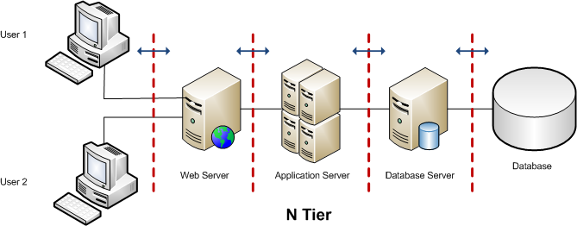
Introduction to N-Layer Architecture
Layers and Tiers
Definition: Layers are about how your code is organized in relation to “concerns” (enforces separation of concerns).
Definition: Tiers are about the where your code/processes are run (across physical hardware).
Important: You can deploy an N-Layer application on a single or multiple tier server solution.
Important: Tiers are not Layers so make sure you use the proper terminology in diagrams, designs, and conversations.
Things to Keep in Mind
Distributing your application across tiers either vertically or horizontally tiers is sometimes required to strike a balance between performance, scalability, fault tolerance, and security.
Crossing a boundary/tier can be expensive. It is on the order of 1000 times slower to make a call across a process boundary on the same machine than to make the same call within the same process. If the call is made across a network this can be even slower.
In general tiers should be minimized unless they are really needed. Tiers may not be a good thing, they are a necessary evil required to obtain certain levels of scalability, fault tolerance or security. A good application architecture (with proper use of technologies) can make adding tiers virtually transparent (via a deployment).

Slide 28
N-Layer Architecture – Client Layer
Client Layer (Sometimes not counted in N – although we should now):
Typically a web browser (but does not need to be) that is responsible for the user interface display on the client (client side).
Minimal data validation (but need to avoid duplicating rules and implementations).
Minimal user interface/application logic. Presentation only.
Supports client side UI Widget Library.

Slide 29
N-Layer Architecture – Presentation Layer
Presentation Layer (PL):
Dynamic (server side) page generation but can also use a Rich Internet Application RIA technology such JavaFX.
Handles user interface events (synchronous and asynchronous).
Implements user interface/application logic (UI Rules).
Handles application/page navigation.
(Should always) Use the Model View Controller (MVC) design pattern.
Supports server side UI Widget Library.

Slide 30
N-Layer Architecture – Business Layer
Business Services Layer (BLL):
Implements business logic (that can be reused across applications if desired).
Implements business rules (that can be reused across applications if desired).
Typically leverages Service Orientated Architecture (SOA) principles and design patterns.
Sometimes referred to as the Services Layer.

Slide 31
N-Layer Architecture – Data Access Layer
Data Access Layer (DAL):
Implements all create, read, update delete (CRUD) operations for persistence of business entities.
Hides (encapsulates) persistence technology and frameworks.
Typically uses the Data Access Object design pattern (enforced thru a common abstract base class).
(Can) use an Object Relational Mapping (ORM) framework for OLTP applications.

Slide 32



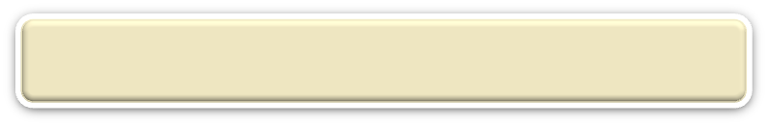


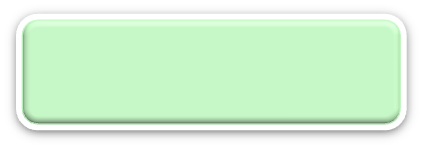


N-Layer Architecture
RIA Design
Client Layer (Desktop/Mobile/Browser)
User Interface, (Minimal) Client Side Validation, AJAX, UI Rules
AJAX
jQuery
CSS
Forms
HTTP/HTTPS POST
Event Based Design
Presentation Layer (PL)
User Interface, UI Event Handlers, UI Rules, Navigation
JSF
Data Validators
Canonical Object Model
Local POJO, SOAP, REST
Design By Contract
Business/Services Layer (BLL)
Business Logic, Business Rules, Workflow, Data Validation
EJB
CDI
JAX-WS and JAX-RS
Application Framework
Custom Reusable Library
Governance
, Standards, Policies, Best Practices,
Security, Steering Committees, Tools, etc.
Canonical Object Model
Canonical Object Model
Reference Architecture
Frameworks, Design Patterns, etc.
Optional SOAP, REST
SOAP, REST
Entity Driven Design
Data Access/Services Layer (DAL)
CRUD Data Persistence
Integration Tier
Orchestration
(Workflow*, Rules*)
Entity Beans (ORM)
Hibernate
iBatis
Data Access Objects
Data Model
JMS, SOAP, .JAXB, Spring
Cache
Operational
Database
External Systems
Interfaces, Feeds, Printers
Business Entity
Media
Governed By
Guided By

Slide 33
Discussion - Why?
Why should you conform to a N-Layer Architecture?
What are the benefits of a N-Layer Architecture?

Slide 34
Benefits - N Layer Application Architecture
Benefits of a Layered Architecture:
Improves maintainability of code by minimizing the impact of change between layers.
Technology should be an implementation detail (thru encapsulation).
Should help enforce a separation of concerns (by loosely coupling code).
Should enable the reuse of code across multiple layers.
Should improve developer productivity.
An N-Tier physical architecture can be supported (if desired).
Enables test driven development (thru mock objects using dependency injection).
Drawbacks of a Layered Architecture:
The problem with layers and various other strategies for loosely-coupling your applications is the addition of needless complexity.
If your application architecture is done incorrectly you run the risk of over architecting an application to allow for various changes that are unlikely to happen and are not based on actual requirements.
Notes:
Questions to class:
What are some disadvantages to multiple layers?
What are some advantages to multiple layers?
For example where technology is an implementation details: changing the way you persist data, from a relational database to XML, for example, will hopefully only affect the Data Access Layer and not so much the Business Layer and User Interface Layer.
For example, a small business can begin running all tiers on a single machine. As traffic and business increases, each tier can be expanded and moved to its own machine and then clustered.
N-Tier Architectures make application more robust because there is no single point of failure. Tiers function with relative independence. For example, if a business changes database vendors, they just have to replace the data tier and adjust the integration tier to any changes that affect it.

Slide 35
N-Tier Architecture

Slide 36
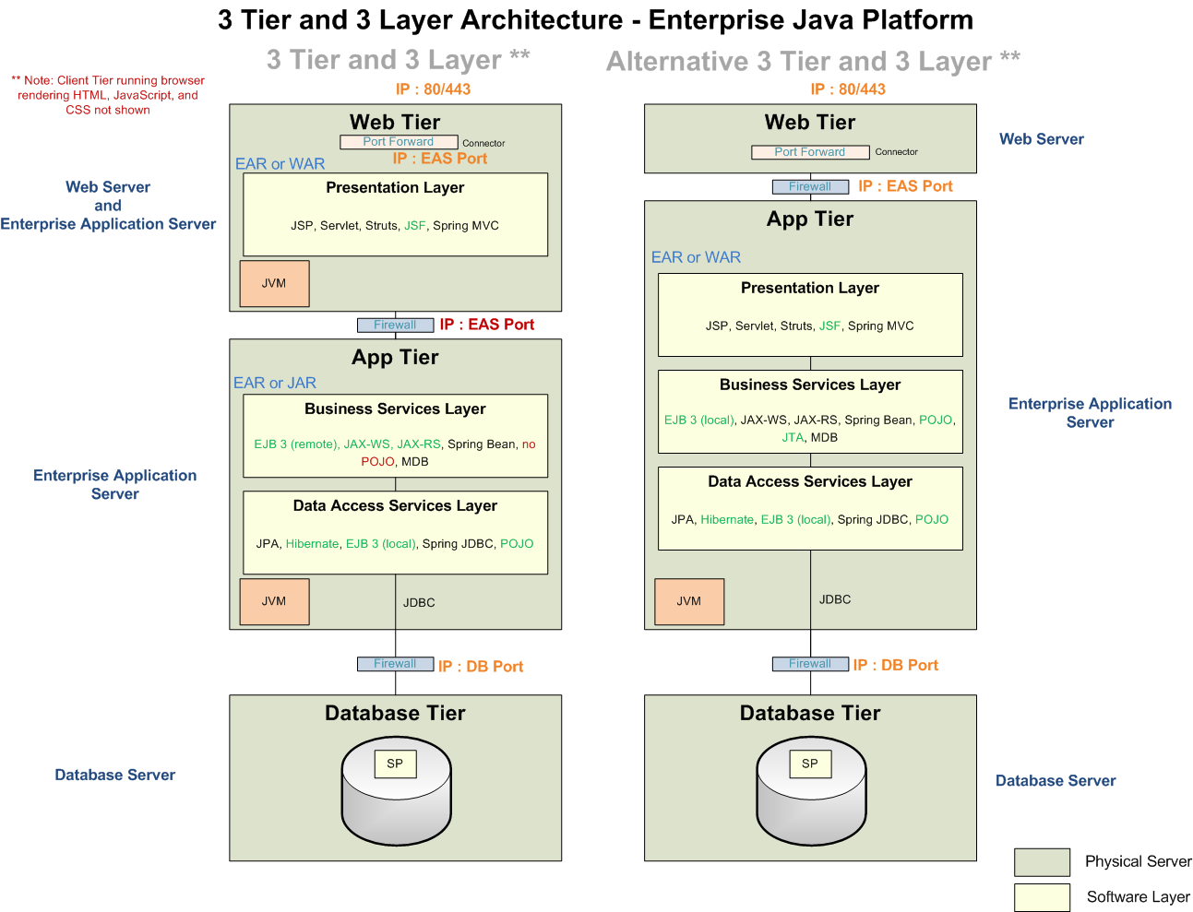
N-Tier Architecture – 3 Tier

Slide 37
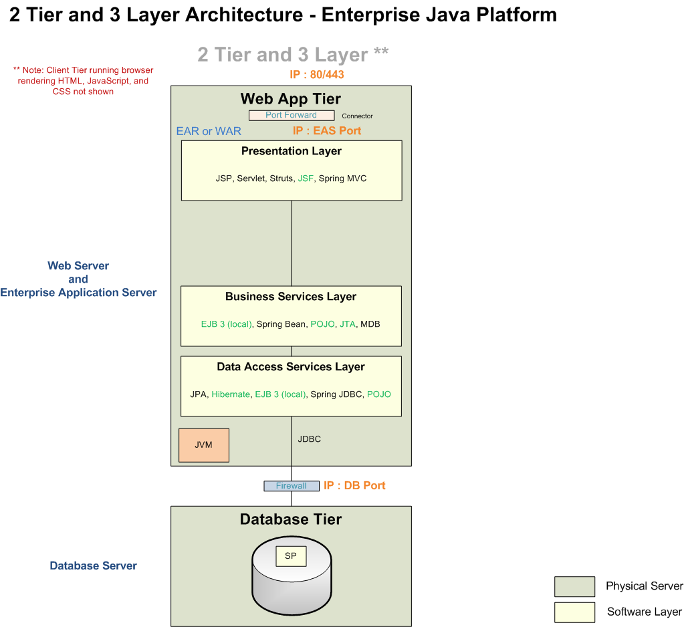
N-Tier Architecture – 2 Tier

Slide 38
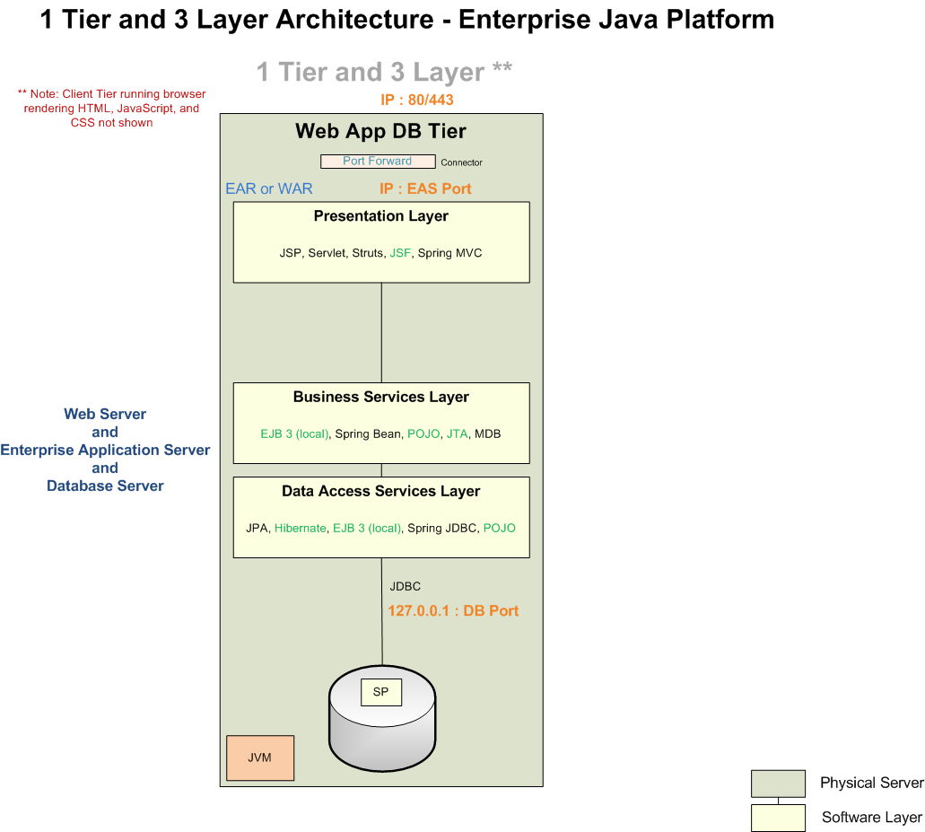
N-Tier Architecture – 1 Tier

Slide 39
Discussion - Why?
What Tier Architecture do you use for development?
Why should you conform to a 2 or 3 Tier Architecture?
What are the benefits of a N-Tier Architecture?

Slide 40
In-Class Activity
Tools Install and Validate Environment
Make sure JBoss Developer Studio and JBoss are installed and working.
See Short Assignment #1 for instructions.
JBoss Developer Studio is your IDE.
JBoss is your Enterprise Java application server.

Slide 41
End of Class

Slide 42
Enterprise Java Technologies

Slide 43
Enterprise Java Technologies ₁
Presentation Layer Technologies:
Servlet – lowest level (above network protocols and sockets) to handle HTTP requests
Java Server Pages – markup (like HTML tags) to build dynamic web pages
Java Standard Template Library – standard tags in a JSP for conditional, loops, etc. (enables dynamic behavior)
Java Server Faces or Spring MVC – web framework (built on top of JSP)
Business/Service Layer Technologies:
Enterprise Java Bean EJB or Spring Beans – business components and business services
Web Services JAX-WS, JAX-B, JAX-RS – web service stack support
Java Messaging Service – receives JMS messages (like MQ)
JTA – programmatic transaction API
Data Access or Persistence Layer Technologies:
JDBC or Spring JDBC – lowest level database programming
Java Persistence API (JPA) – Object Relational Mapping (ORM) framework
Integration Layer Technologies:
Java Connector Architecture JCA – API to access legacy systems (like SAP, PeopleSoft, etc.)
Java Messaging Service – send JMS messages (like MQ)
Web Services JAX-WS, JAX-B, JAX-RS – web service stack support

Slide 44
Enterprise Java Technologies ₂
Java EE Application Layers
Client Layer
Desktop browser, mobile phone, STB, TV
Browser
Creates views for presentation, handling form data, and navigation
Presentation Layer
You Will Apply:
HTML, CSS, JavaScript, JSP, Servlets, JSF.
Business Layer
Implements business services and enterprise integration services
You Will Apply:
EJB, Web Services, Message Driven Beans, Timer Beans
Data Access Layer
Implements data persistence services
You Will Apply:
JPA, SQL

Slide 45
Application Framework
Purpose:
Reusable application agnostic / application independent framework
Reusable base classes (placeholders for reusable logic and for future refactoring)
Encapsulates common utility functions
Enable consistency within the architecture
Enable easy onboard of future architects and developers
One goal should be to separate application dependencies out of the framework
Application Framework:
Base Classes
Logging Wrapper
Tracing Wrapper
Exception Wrapper
Reference Data Service
Application Independent Helper /Utility Classes (security, custom tags, custom components, etc)
Common canonical model
Approved technologies, best practices, prescriptive guidance, and frameworks are often standardized and packaged via a Reference Architecture

Slide 46
N-Layer Architecture
RIA Design
Client Layer (Desktop/Mobile/Browser)
User Interface, (Minimal) Client Side Validation, AJAX, UI Rules
AJAX
jQuery
CSS
Forms
HTTP/HTTPS POST
Event Based Design
Presentation Layer (PL)
User Interface, UI Event Handlers, UI Rules, Navigation
JSF
Data Validators
Canonical Object Model
Local POJO, SOAP, REST
Design By Contract
Business/Services Layer (BLL)
Business Logic, Business Rules, Workflow, Data Validation
EJB
CDI
JAX-WS and JAX-RS
Application Framework
Custom Reusable Library
Governance
, Standards, Policies, Best Practices,
Security, Steering Committees, Tools, etc.
Canonical Object Model
Canonical Object Model
Reference Architecture
Frameworks, Design Patterns, etc.
Optional SOAP, REST
SOAP, REST
Entity Driven Design
Data Access/Services Layer (DAL)
CRUD Data Persistence
Integration Tier
Orchestration
(Workflow*, Rules*)
Entity Beans (ORM)
Hibernate
iBatis
Data Access Objects
Data Model
JMS, SOAP, .JAXB, Spring
Cache
Operational
Database
External Systems
Interfaces, Feeds, Printers
Business Entity
Media
Governed By
Guided By

Slide 47
Design Report Template

Slide 48
Review Project Design Report
For each assignment you will submit a document that includes the main purpose of the project or portion of the assignment, a detailed description of their implementation approach that includes a Flow Chart (required) and UML Class diagram (required), pseudo code (if applicable), and a code stubs with comments (if applicable), etc.. These will be due as part of your In-Class Activity assignments. This will be a “living” design specification that you will update for every assignment.
Please pull up the Design Report Template from your Student Materials that I posted in the Notification Message:
Review Intro Section
Review Approach Section
Review Supporting Documentation
Pseudo Code?
UML?
Code Stubs?

Slide 49
Discussion – Concerns After Week 1?
What are you excited about learning in this class?
What do you think will be the most challenging?
What are you most nervous/anxious about?

Slide 50
In-Class Activity
N-Layer Research
Use your Lecture Notes from this week and Google.
See Short Assignment #1 for instructions.

Slide 51
Weekend Reminders
Pick your Team Member. Post as a response in the Announcement.
Make sure JBoss Developer Studio and JBoss are working.
Submit Milestone #1 Project Assignment.
Submit In-Class Activity #1 Report to the Main Forum.
I need a list of your team members!

Slide 52
End of Class

